Slide 1


Problem Solving on DFA
Session No.: 5 Course Name: Theory of Computation Course Code: R1UC428T Instructor Name: Arvind Kumar Duration: 50 mins
Galgotias University

Slide 2

At the end of this session, you will be able to:
LO1: Construct DFA step by step
LO2: Analyze DFA correctness
Galgotias University

Slide 3
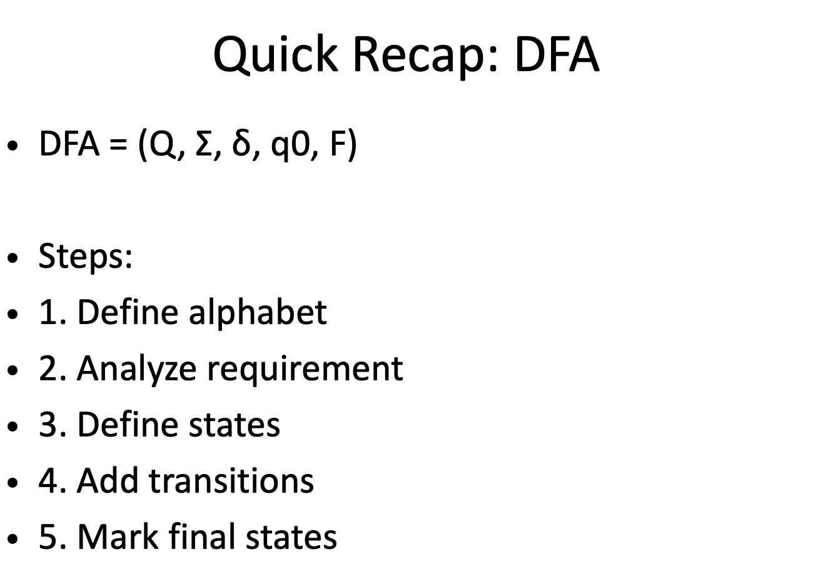
Galgotias University

Slide 4
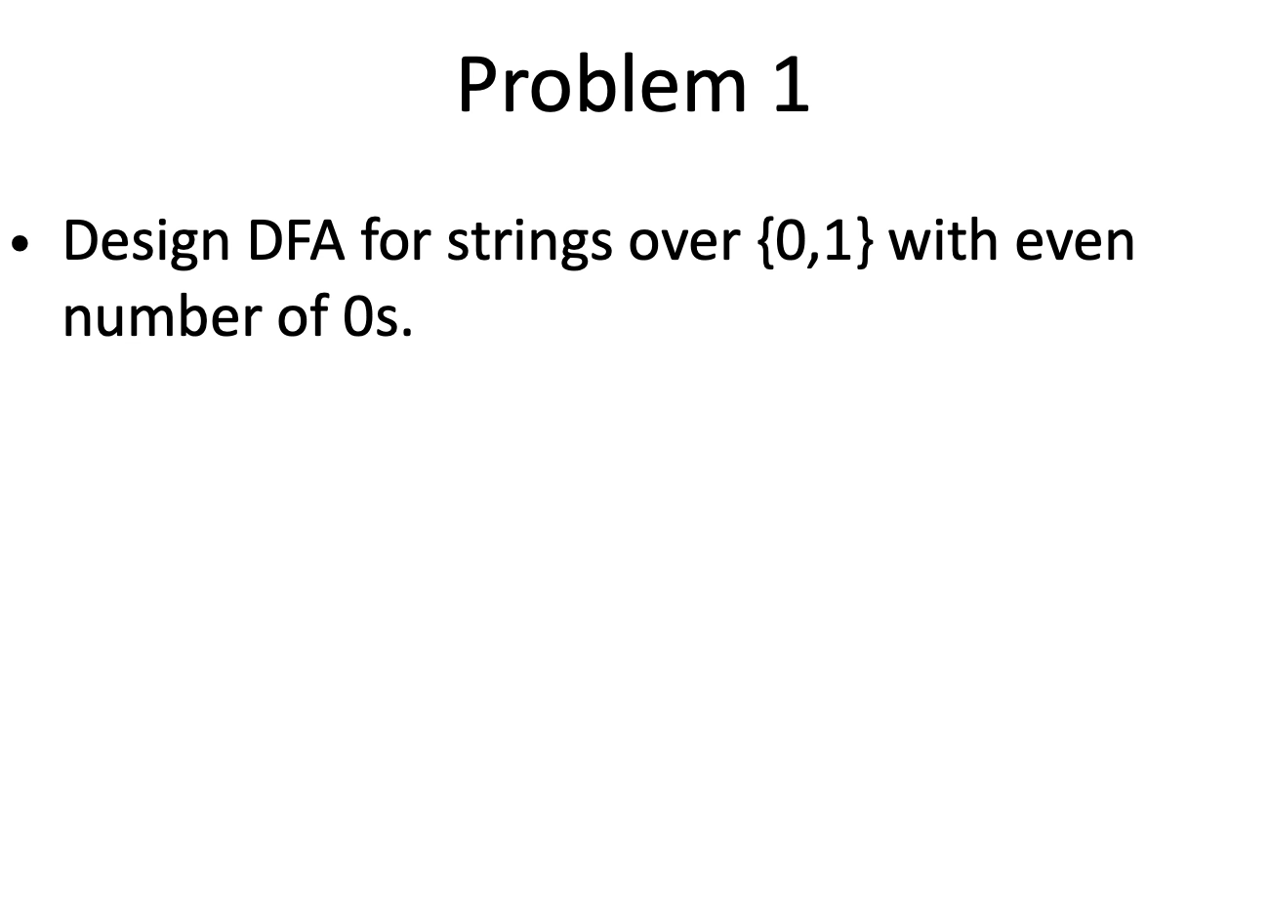
Galgotias University

Slide 5
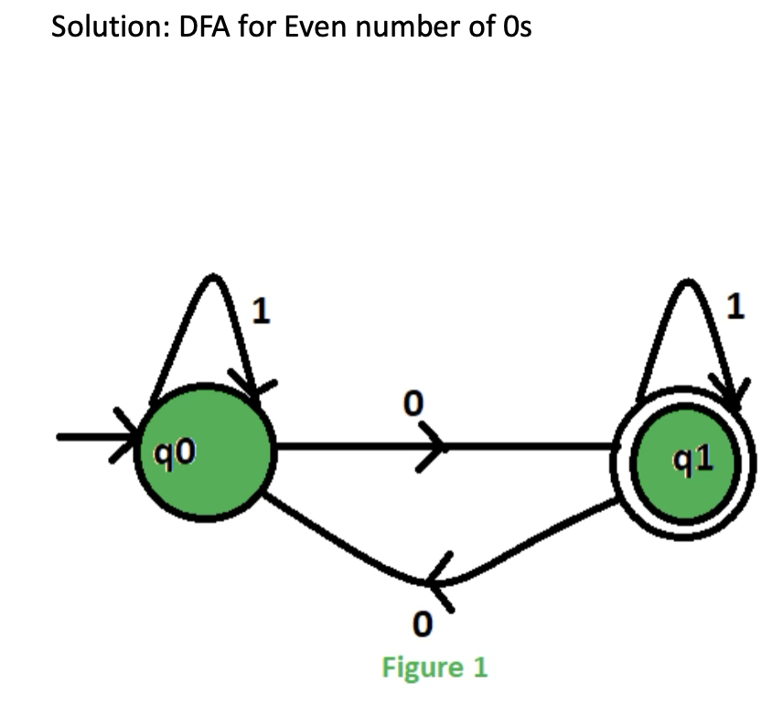
Galgotias University

Slide 6
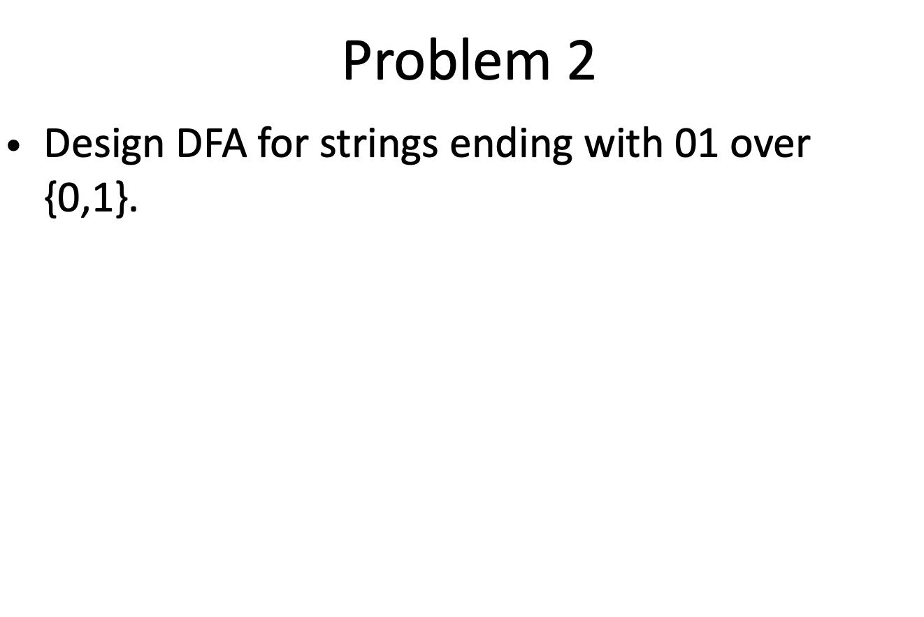
Galgotias University

Slide 7
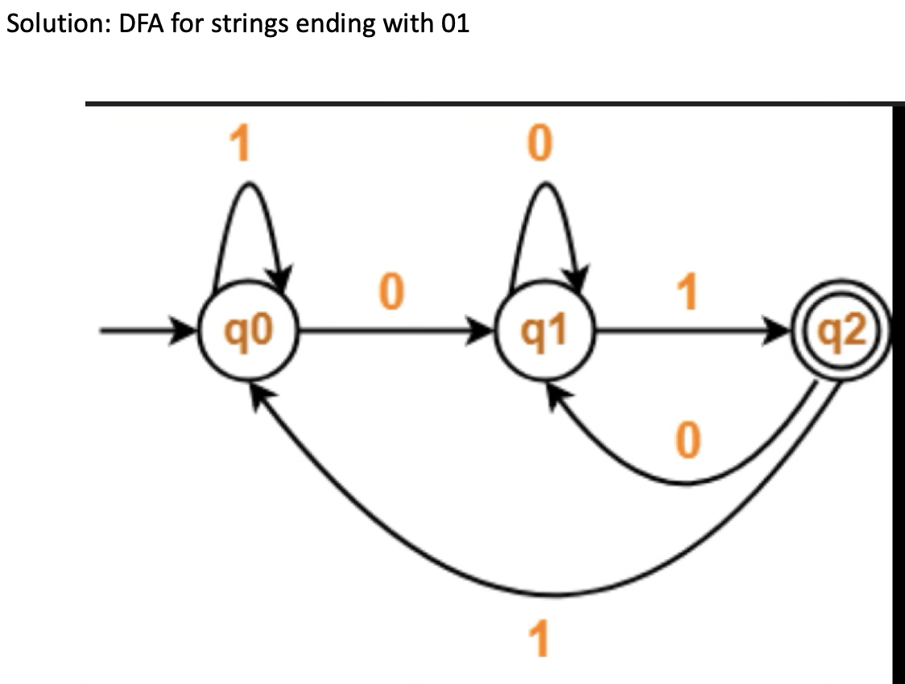
Galgotias University

Slide 8
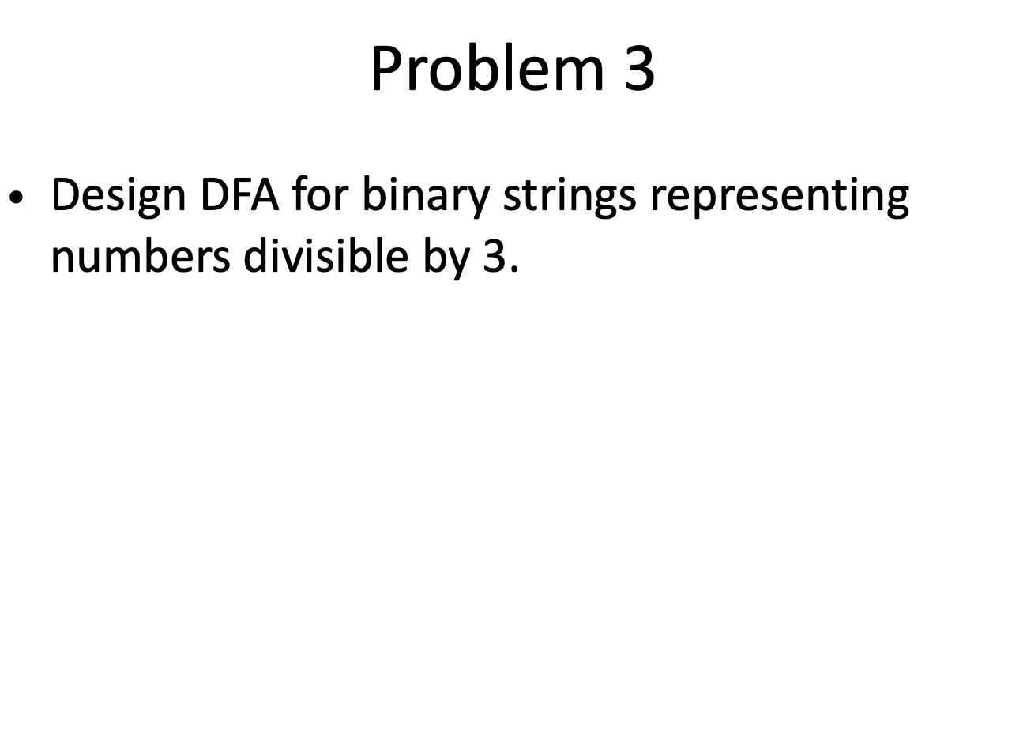
Galgotias University

Slide 9
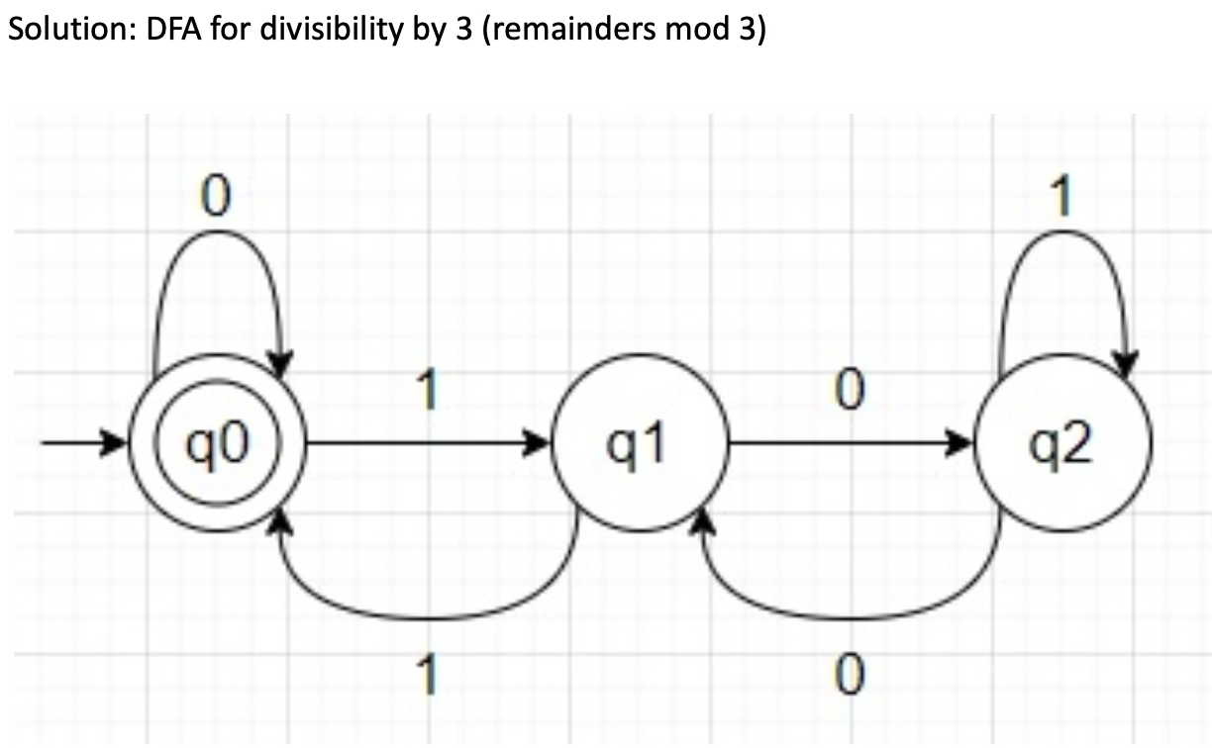
Galgotias University

Slide 10
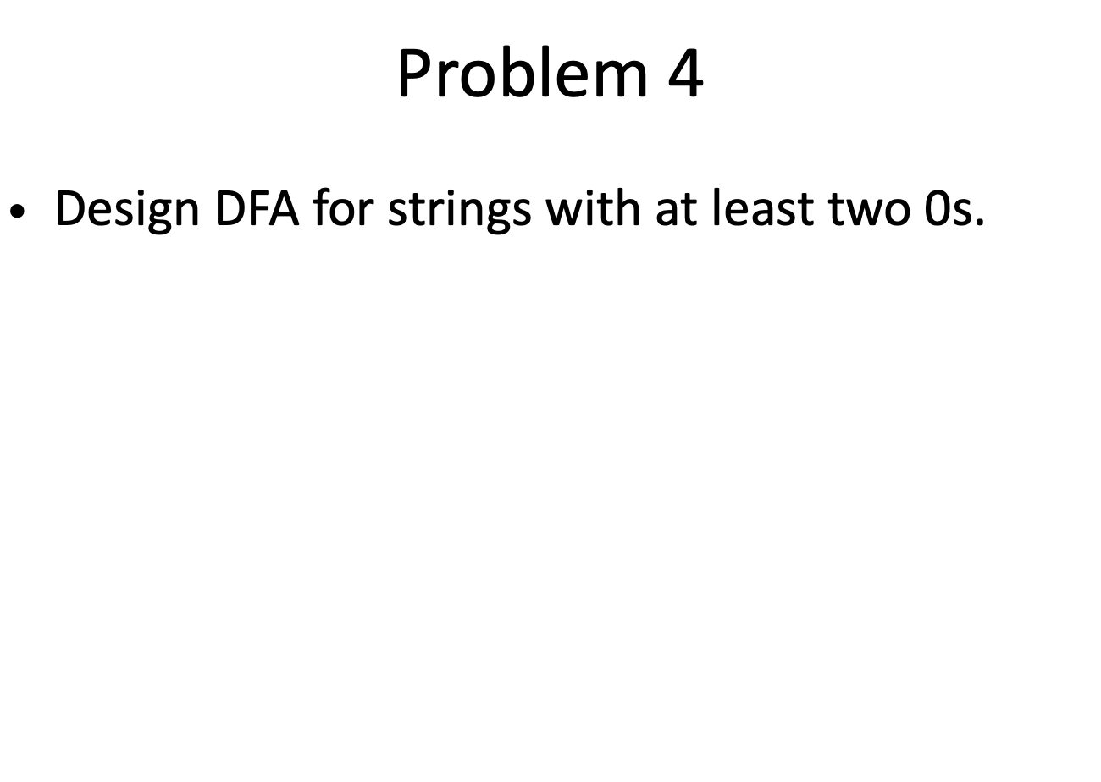
Galgotias University

Slide 11
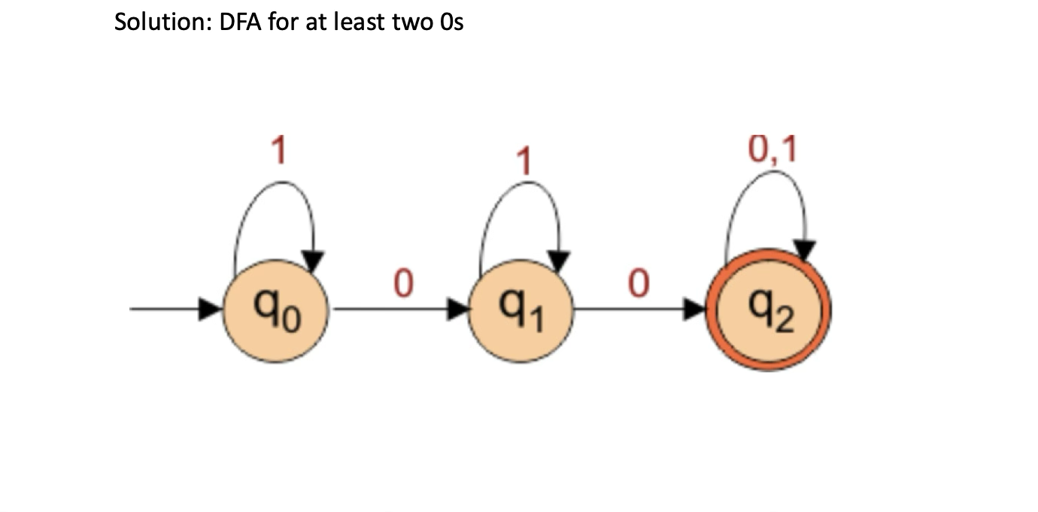
Galgotias University

Slide 12
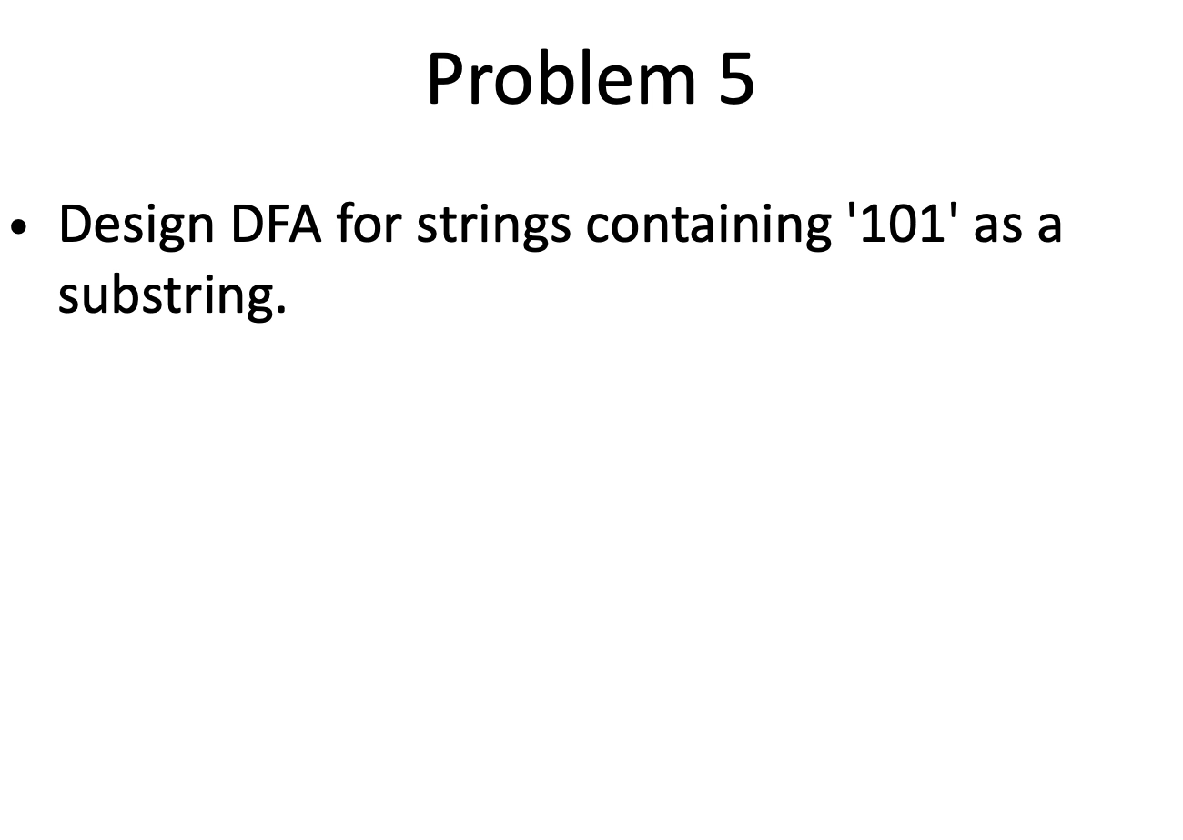
Galgotias University

Slide 13
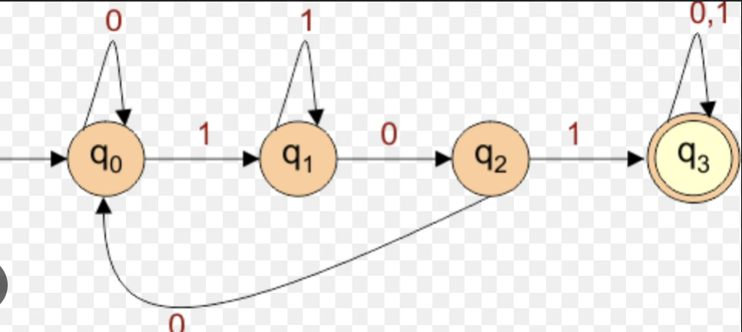
Solution: DFA for substring '101'

Slide 14
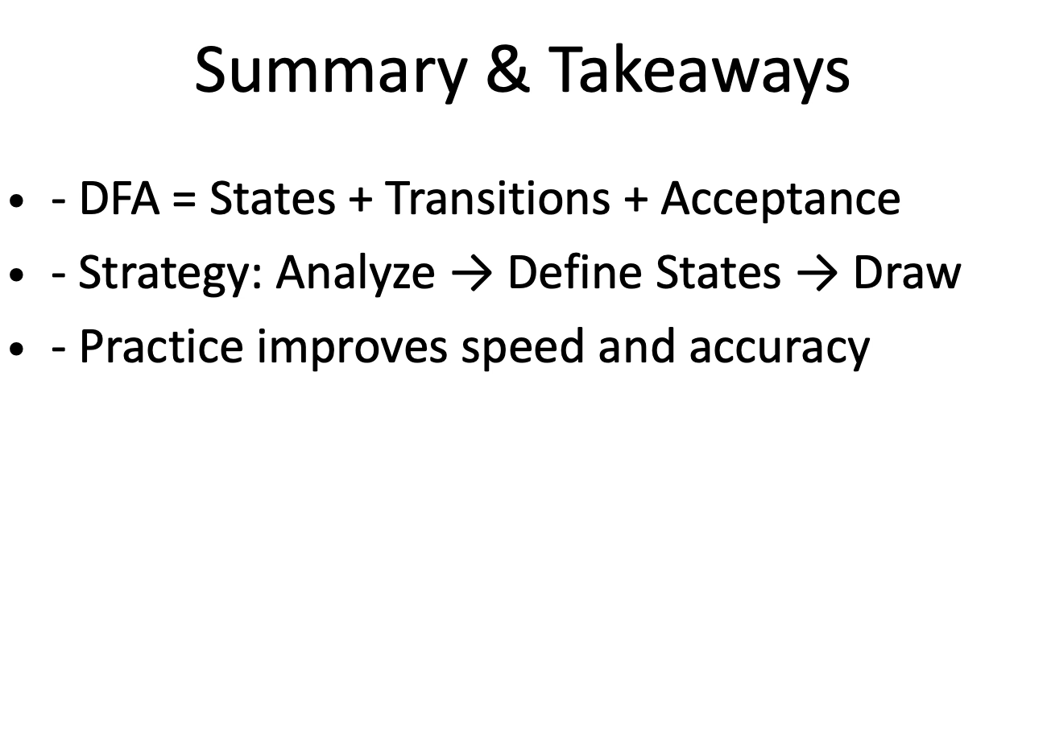
16

Slide 15
Discussion on the post session activities
Attempt the Post-Session-6 Quiz on LMS.
Galgotias University

Slide 16
Information about the next lesson
Revision / Tutorial.
Galgotias University

Slide 17
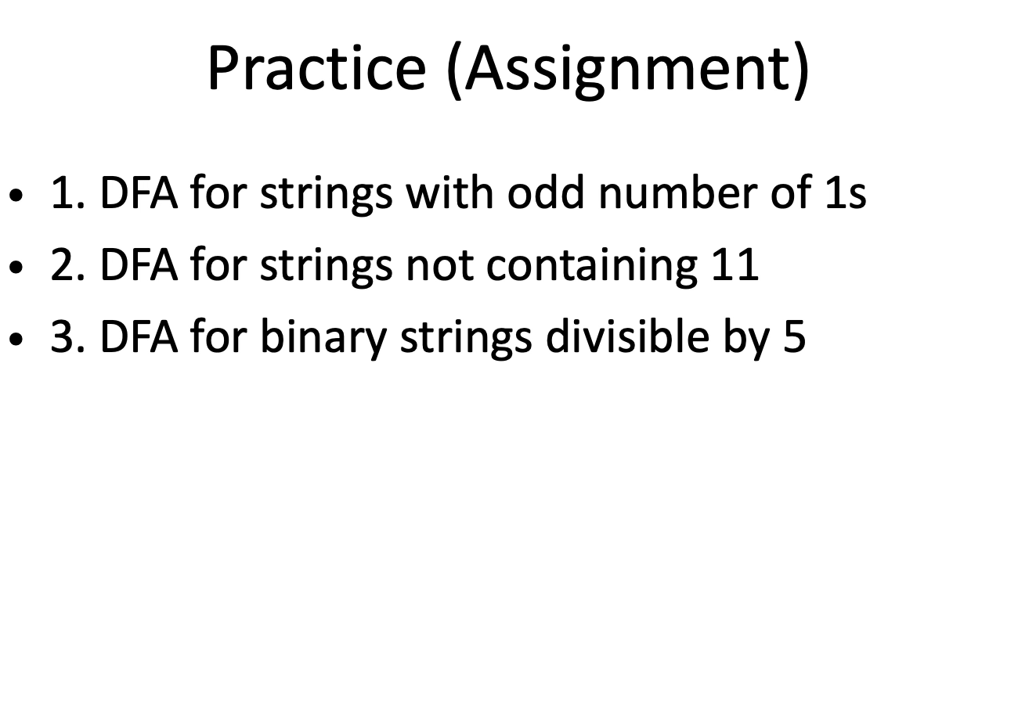
17

Slide 18

Galgotias University

